Slide 1

Linear regression
CSE451:Neural Network & Fuzzy Logic
Presented By
MD Tamim Hossain
Lecturer
Department of Computer Science and Engineering
Premier University
“It is easy to be beautiful; it is difficult to appear so.”
-Hosea Ballou

Slide 2
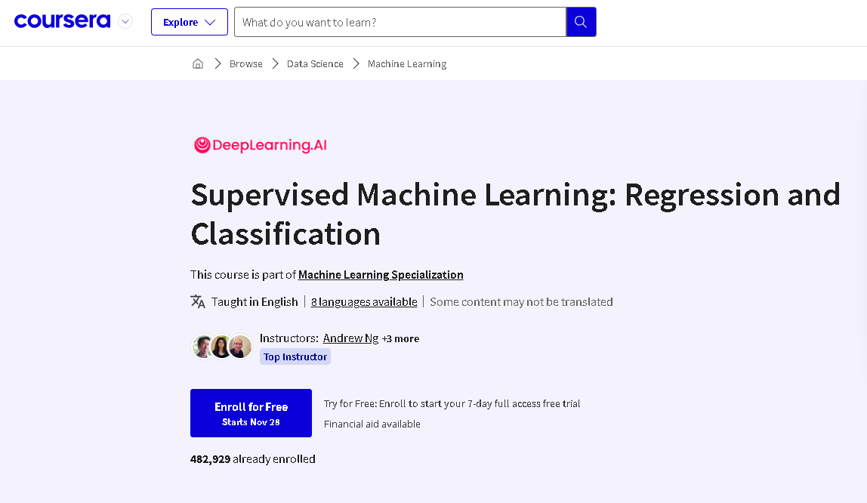

Slide 3


Slide 4
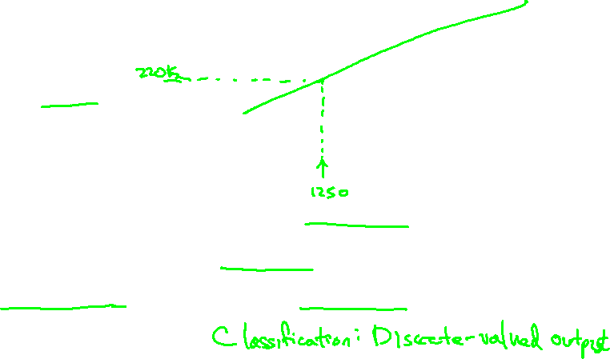
Housing Prices
(Portland, OR)
Price
(in 1000s of dollars)
Size (feet²)
Supervised Learning
Given the “right answer” for each example in the data.
Regression Problem
Predict real-valued output

Slide 5
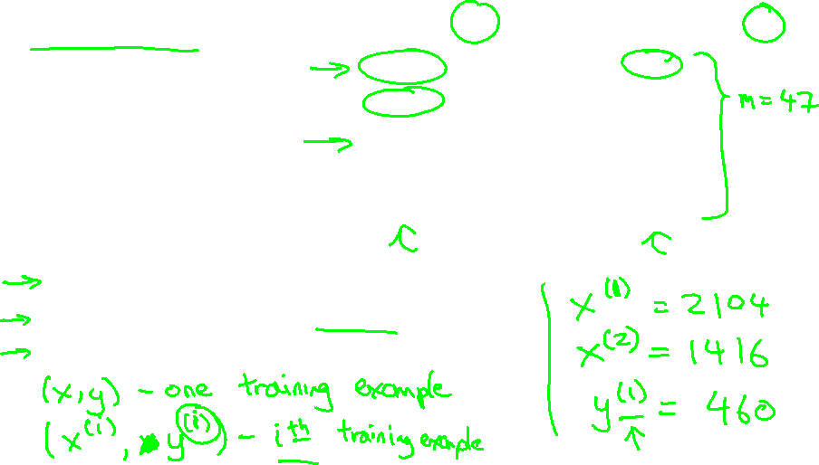
Training set of
housing prices
(Portland, OR)
Size in feet² (x) | Price ($) in 1000's (y)
2104 | 460
1416 | 232
1534 | 315
852 | 178
… | …
Notation:
m = Number of training examples
x’s = “input” variable / features
y’s = “output” variable / “target” variable

Slide 6
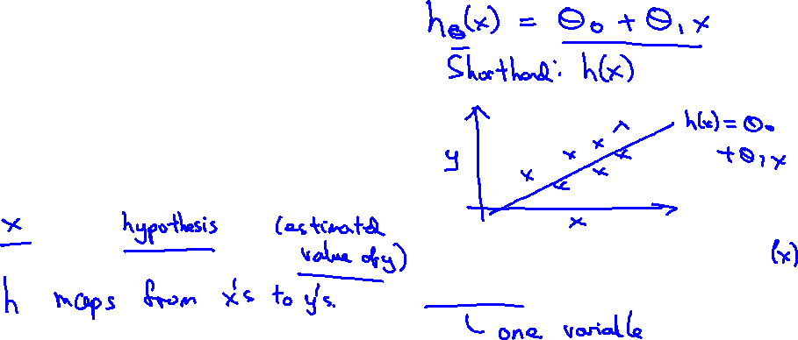
Training Set
How do we represent h ?
Learning Algorithm
Size of house
h
Estimated price
Linear regression with one variable.
Univariate linear regression.

Slide 8
Cost function
Linear regression with one variable
Machine Learning

Slide 9
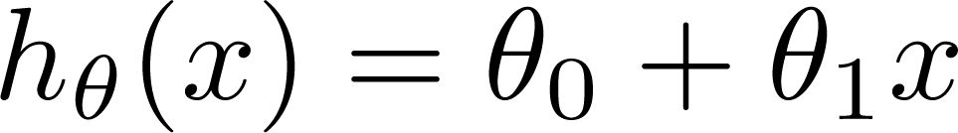

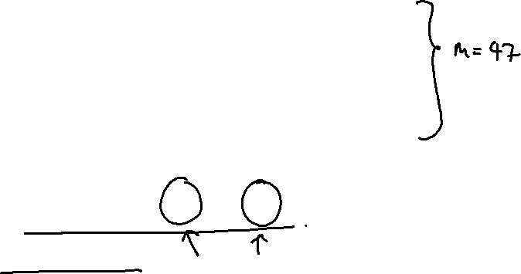
Training Set
Size in feet² (x) | Price ($) in 1000's (y)
2104 | 460
1416 | 232
1534 | 315
852 | 178
… | …
Hypothesis:
‘s: Parameters
How to choose ‘s ?

Slide 10
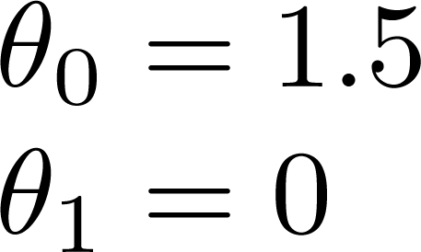
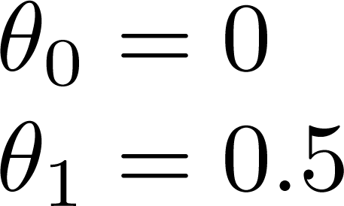
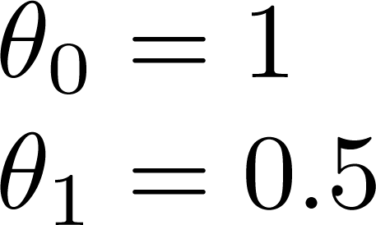
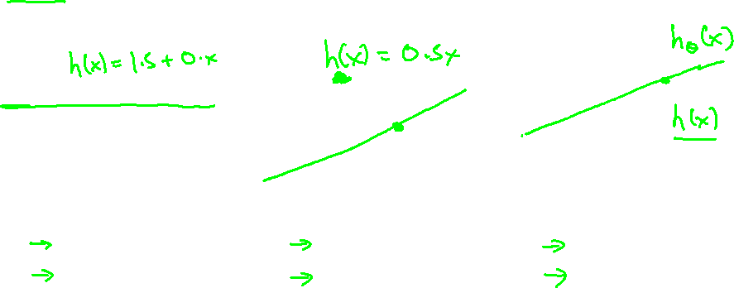

Slide 11
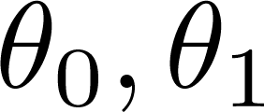


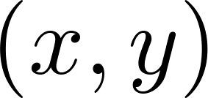
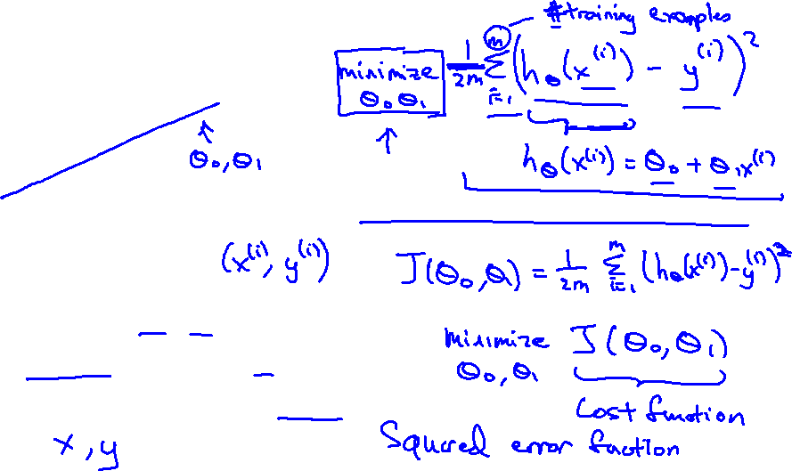
y
x
Idea: Choose so that is close to for our training examples

Slide 13
Cost function intuition I
Linear regression with one variable
Machine Learning

Slide 14
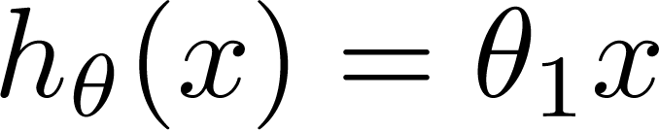

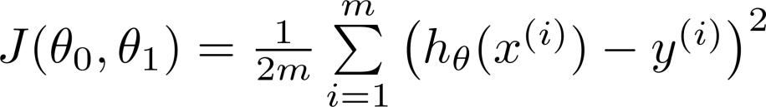
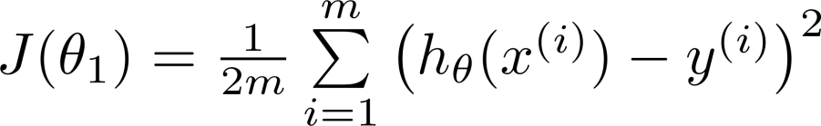
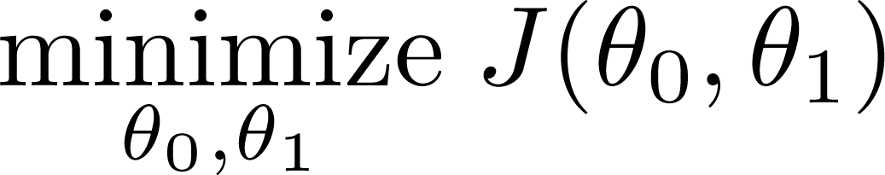
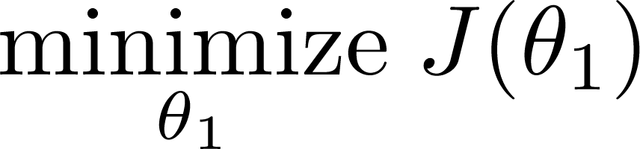
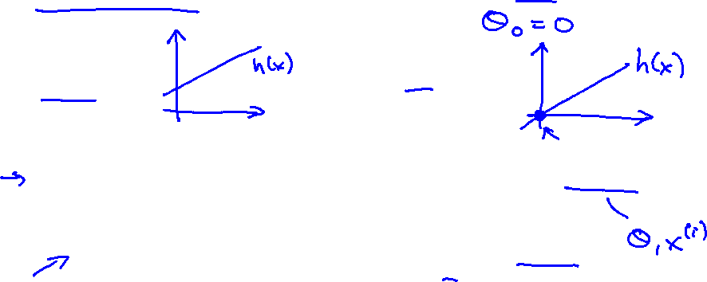
Simplified
Hypothesis:
Parameters:
Cost Function:
Goal:

Slide 15





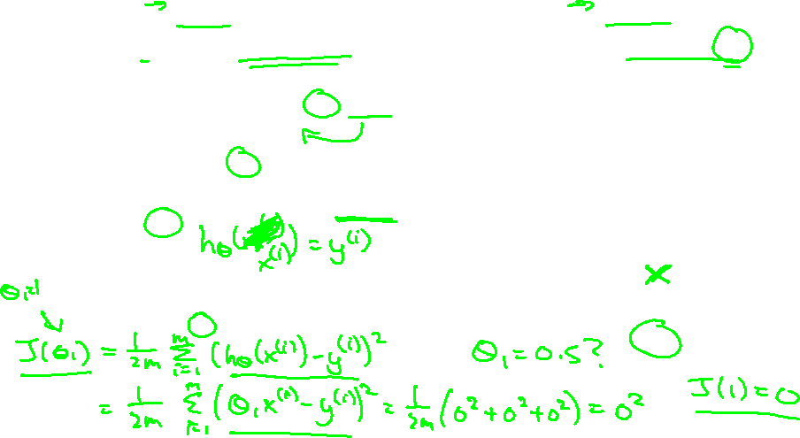
(for fixed , this is a function of x)
(function of the parameter )
y
x

Slide 16

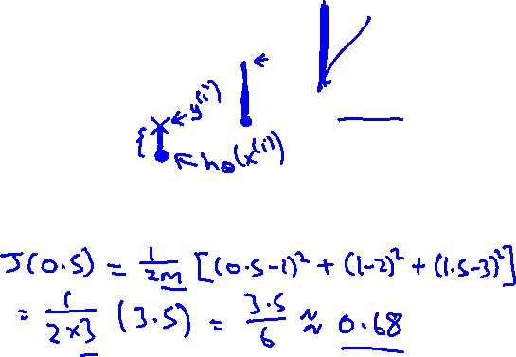
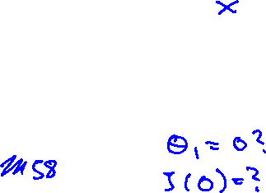
(for fixed , this is a function of x)
(function of the parameter )
y
x

Slide 17

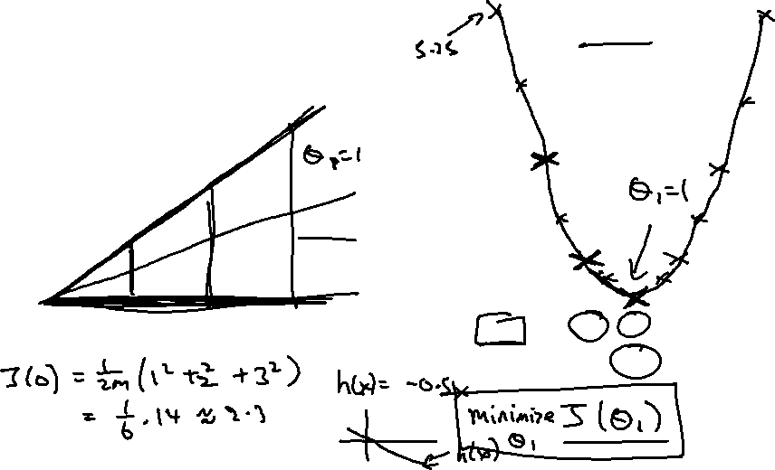
(for fixed , this is a function of x)
(function of the parameter )
y
x

Slide 19
Cost function intuition II
Linear regression with one variable
Machine Learning

Slide 20
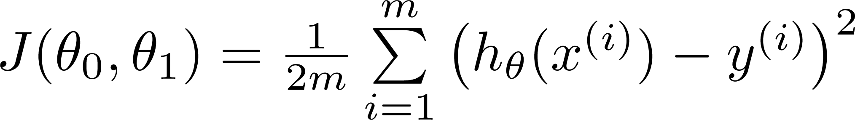

Hypothesis:
Parameters:
Cost Function:
Goal:

Slide 21
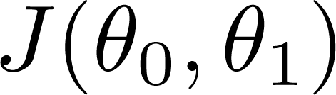


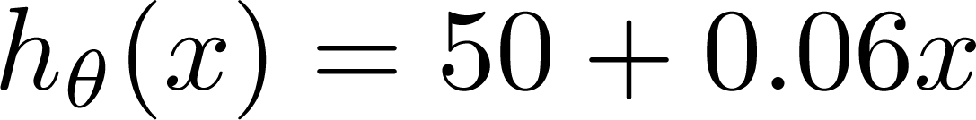
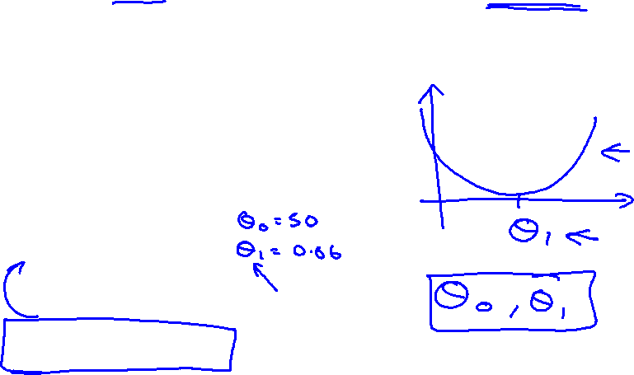
(for fixed , this is a function of x)
(function of the parameters )
Price ($)
in 1000’s
Size in feet² (x)

Slide 22
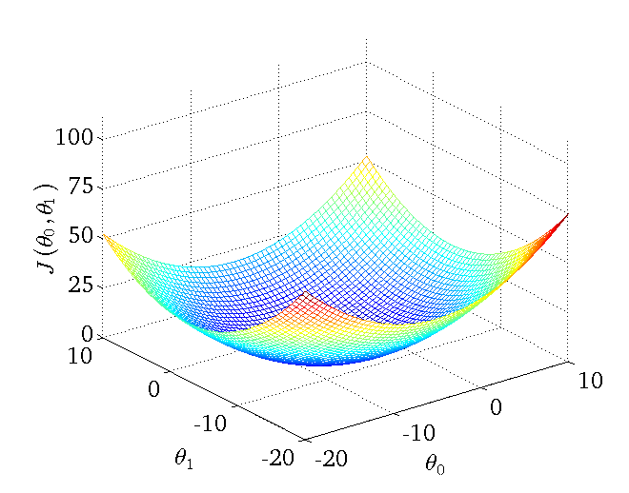
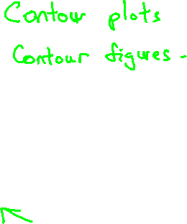
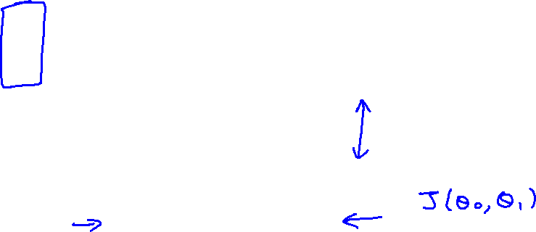

Slide 23
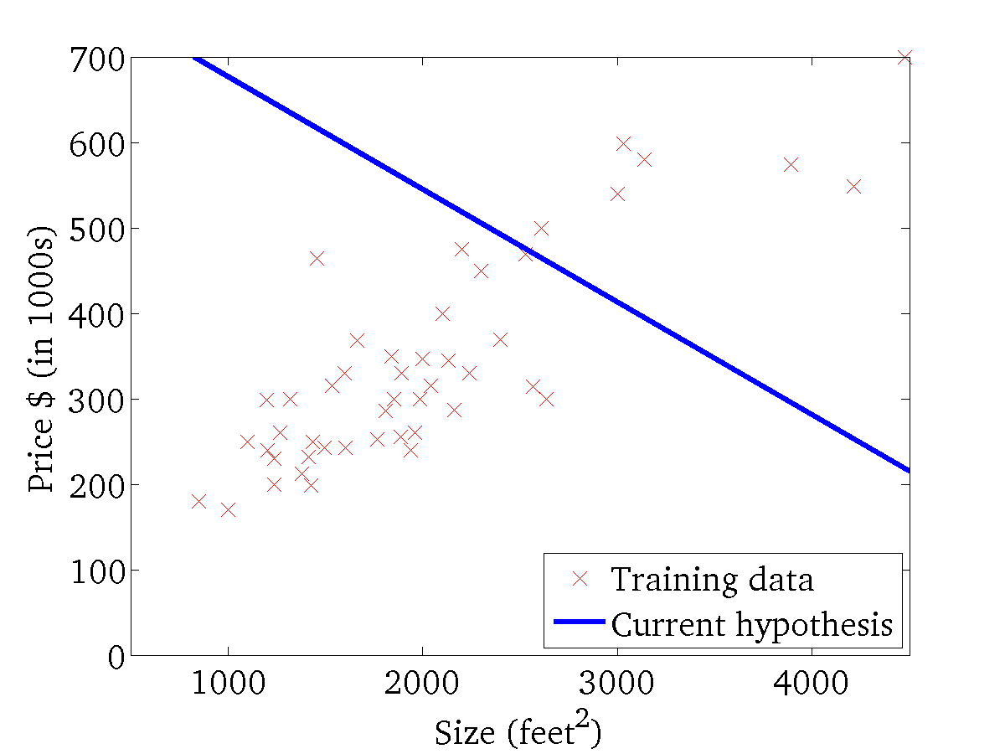
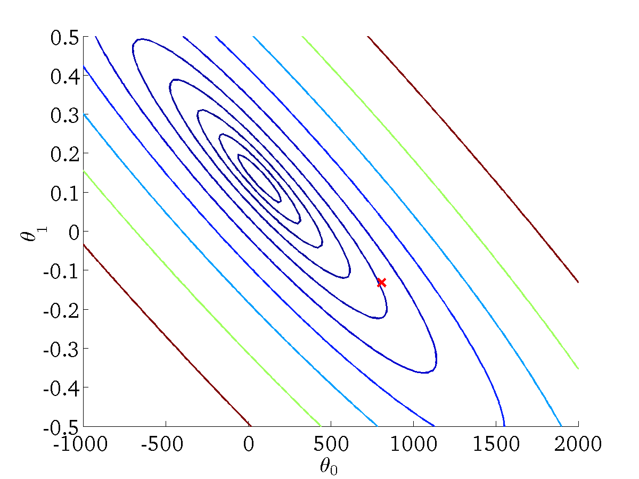
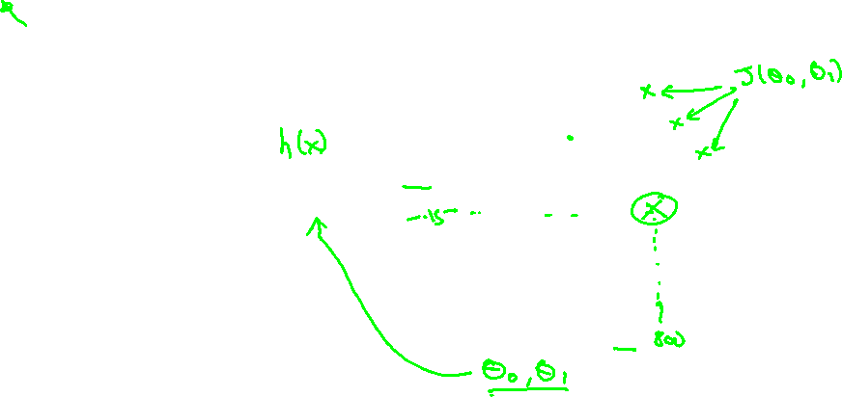
(for fixed , this is a function of x)
(function of the parameters )

Slide 24
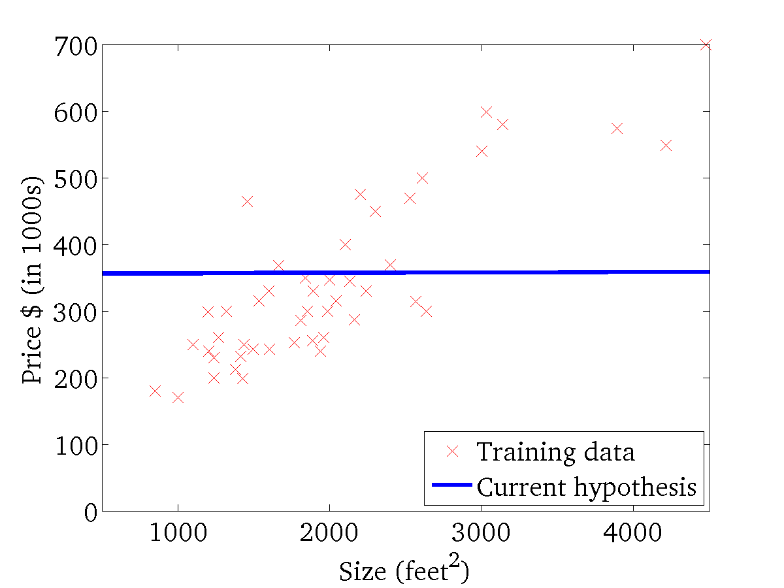
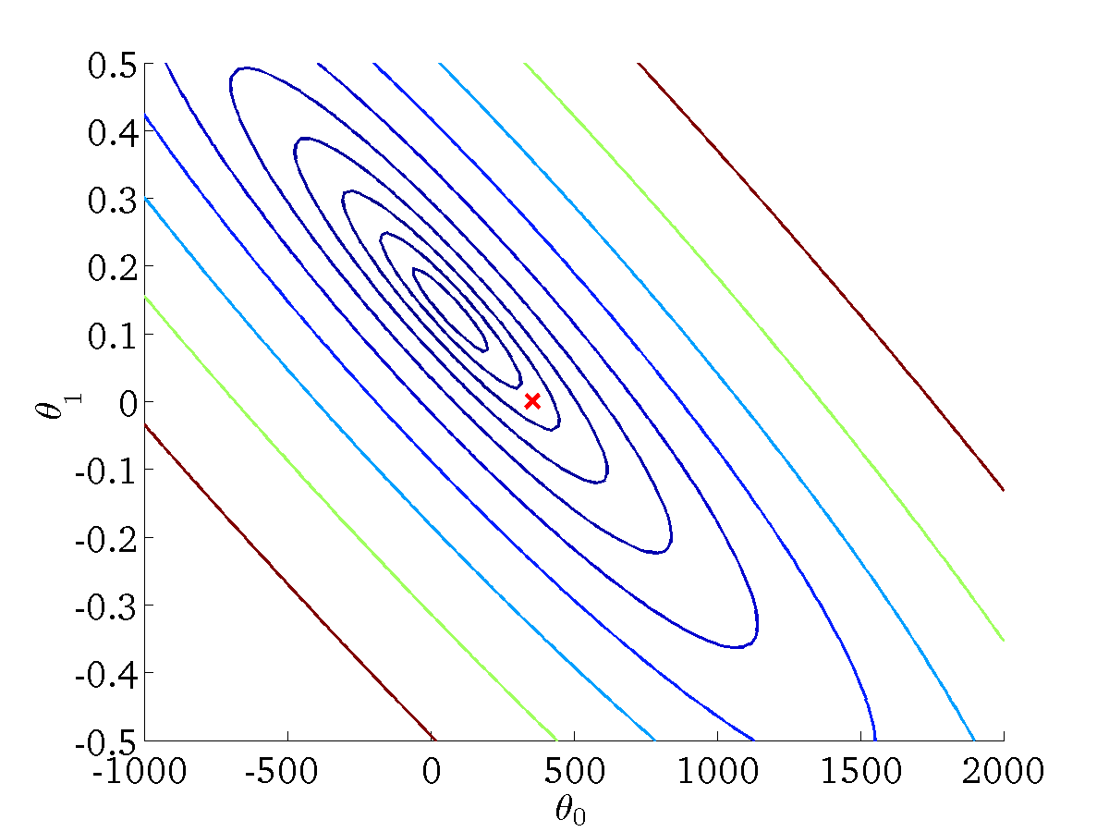
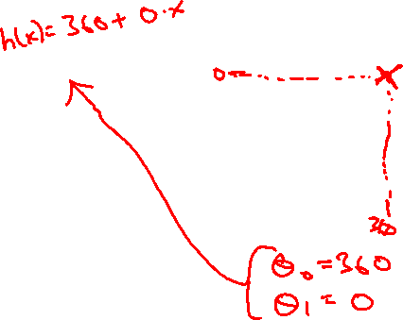
(for fixed , this is a function of x)
(function of the parameters )

Slide 25
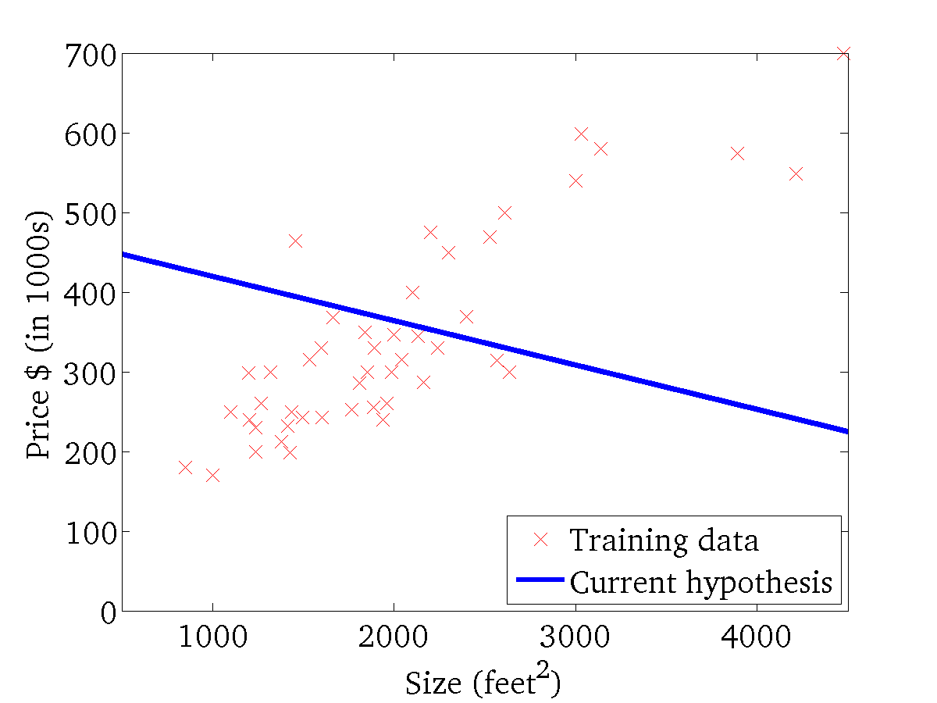

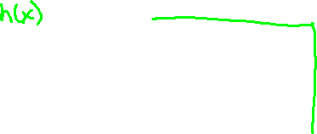
(for fixed , this is a function of x)
(function of the parameters )

Slide 26
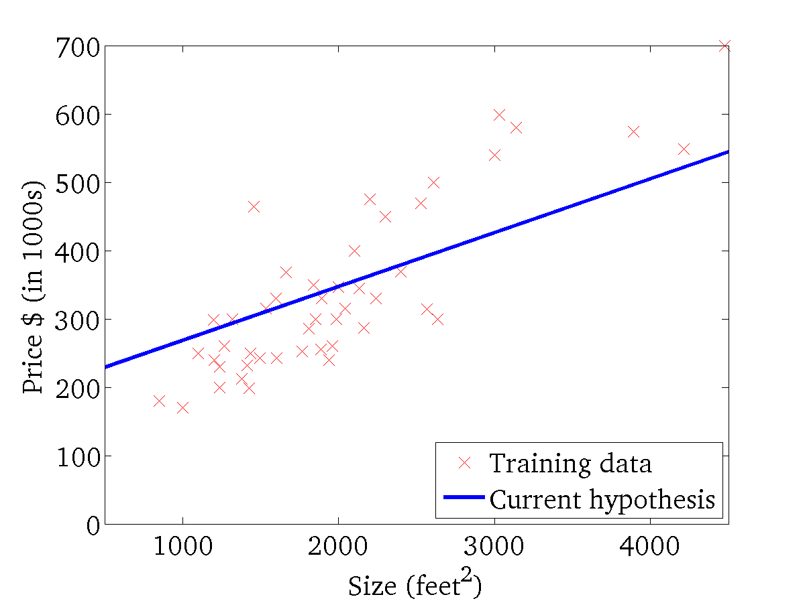
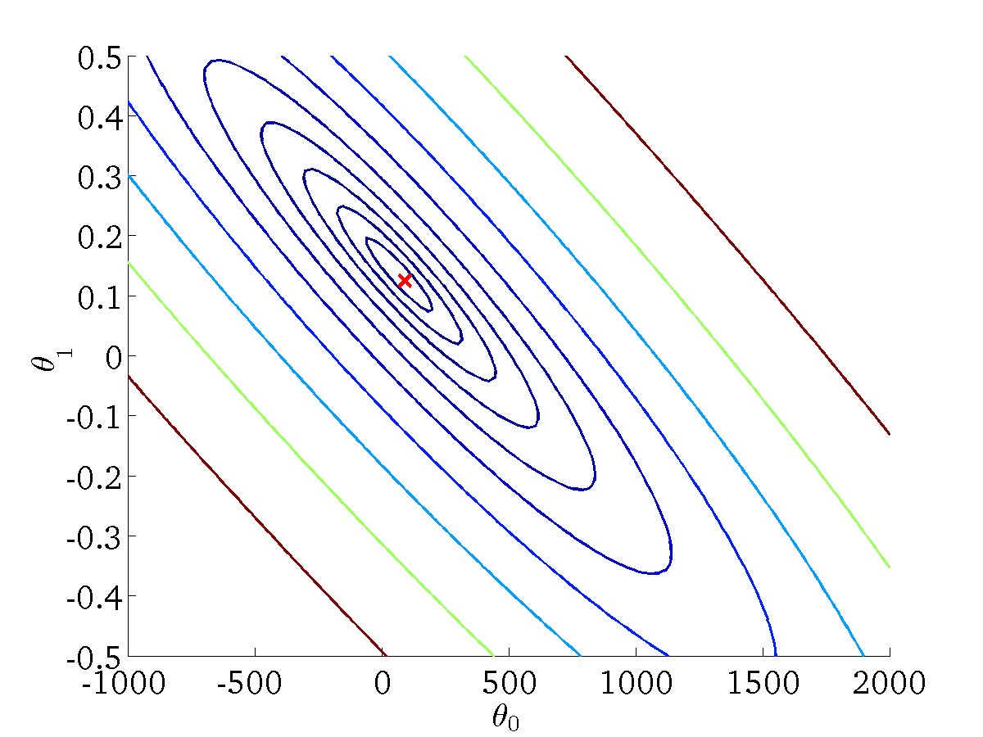
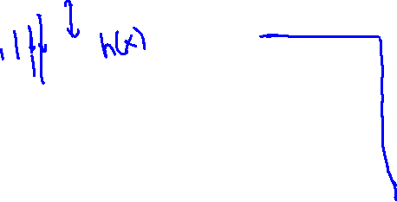
(for fixed , this is a function of x)
(function of the parameters )

Slide 28
Gradient descent
Linear regression with one variable
Machine Learning

Slide 29
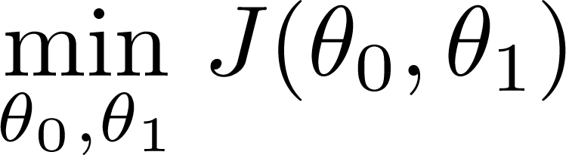
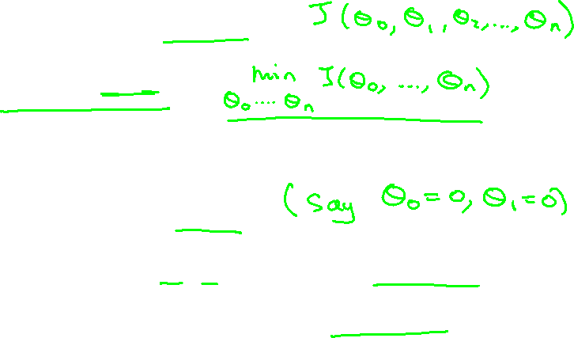
Have some function
Want
Outline:
  Start with some
  Keep changing to reduce until we hopefully end up at a minimum

Slide 30
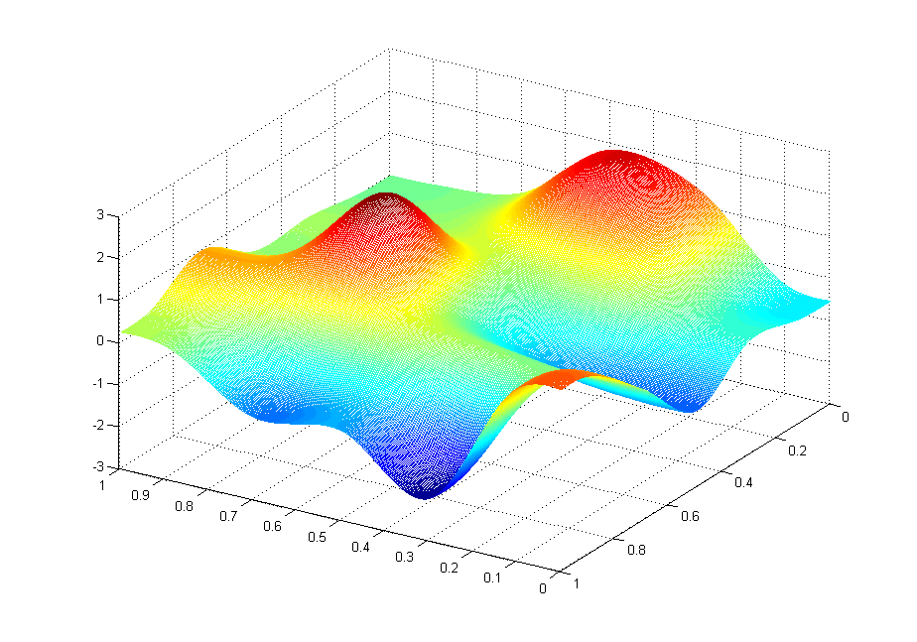

J(θ₀,θ₁)
θ₁
θ₀

Slide 31
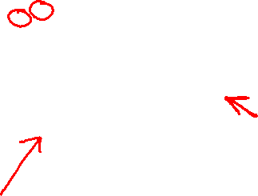
J(θ₀,θ₁)
θ₁
θ₀

Slide 32
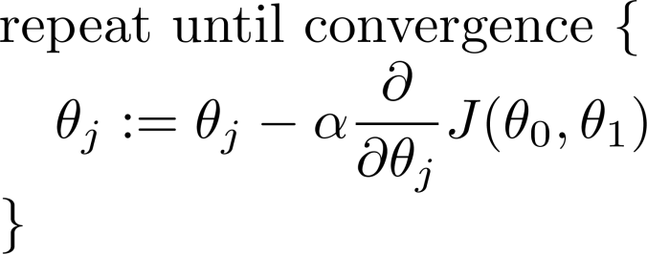
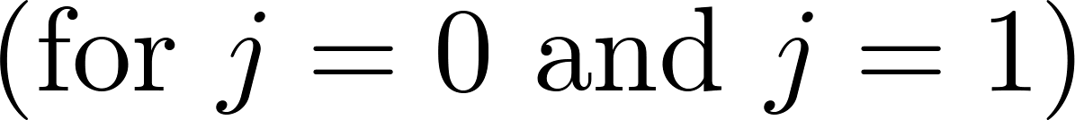
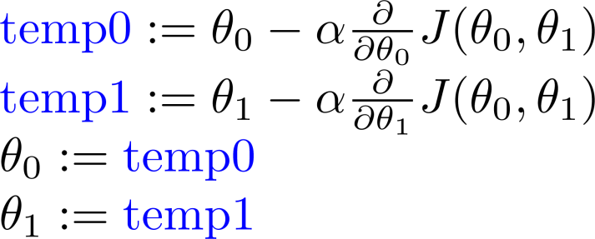
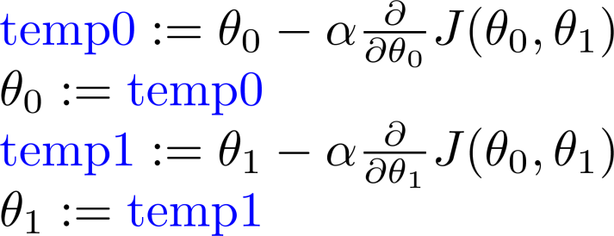
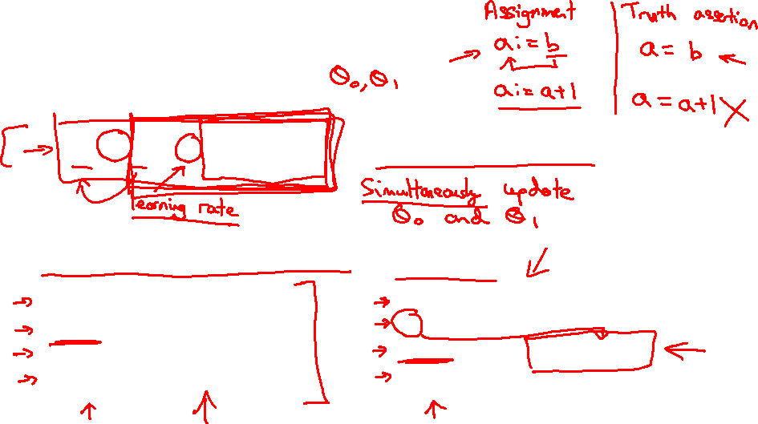
Gradient descent algorithm
Correct: Simultaneous update
Incorrect:

Slide 34
Gradient descent intuition
Linear regression with one variable
Machine Learning

Slide 35



Gradient descent algorithm

Slide 36


Slide 37


If α is too small, gradient descent can be slow.
If α is too large, gradient descent can overshoot the minimum. It may fail to converge, or even diverge.

Slide 38




at local optima
Current value of

Slide 39

Gradient descent can converge to a local minimum, even with the learning rate α fixed.
As we approach a local minimum, gradient descent will automatically take smaller steps. So, no need to decrease α over time.

Slide 41
Gradient descent for linear regression
Linear regression with one variable
Machine Learning

Slide 42


Gradient descent algorithm
Linear Regression Model

Slide 43





Slide 44



Gradient descent algorithm
update
and
simultaneously

Slide 45

J(θ₀,θ₁)
θ₁
θ₀

Slide 46
J(θ₀,θ₁)
θ₁
θ₀

Slide 47


Slide 48



(for fixed , this is a function of x)
(function of the parameters )

Slide 49

(for fixed , this is a function of x)
(function of the parameters )

Slide 50


(for fixed , this is a function of x)
(function of the parameters )

Slide 51


(for fixed , this is a function of x)
(function of the parameters )

Slide 52

(for fixed , this is a function of x)
(function of the parameters )

Slide 53

(for fixed , this is a function of x)
(function of the parameters )

Slide 54


(for fixed , this is a function of x)
(function of the parameters )

Slide 55

(for fixed , this is a function of x)
(function of the parameters )

Slide 56



(for fixed , this is a function of x)
(function of the parameters )

Slide 57

“Batch” Gradient Descent
“Batch”: Each step of gradient descent uses all the training examples.

